Slide 1
Software Development life cycle
Presented By
GANAVI.J

Slide 2
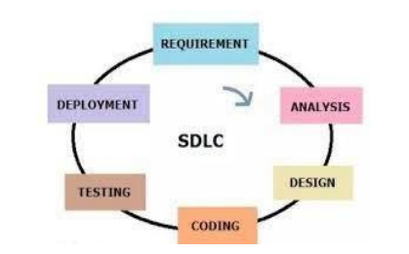
Software Development life cycle:-(SDLC)
Software Development life cycle is a process used by the software industry to design, develop and test high quality software’s. The SDLC aims to produce high quality software the meets or exceeds customer expectations, reaches the completion within time and cost estimated.

Slide 3
SDLC Phases
Requirements and Analysis :-Requirement Analysis phases, where the stakeholder discuss the requirements of the software that needs to be developed to achieve a goal.
Design :-During the design phase, developers start the high level design of the software and system to be able to deliver each requirement.
Coding :-In this phase, developers start coding according to the requirement and the design in the previous phases.
Testing :-In this phase, testers start to test the system against the requirements. The testers aim to find defects within the system as well as verifying the application and according to what was documented in the requirements analysis.
Deployment :- Once the software has been fully tested and no issues remain in the software, it is a time to deploy to production where customers can use the system.

Slide 4
Life Cycle Models
Waterfall model
Agile model
Iterative model

Slide 5
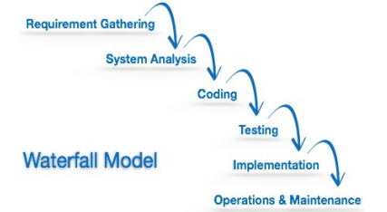
Waterfall model
Is the simplest model of software development paradigm. It says the all phases of the SDLC will function one after another in linear manner. That is when the first phase is finished then only the second phase will start and soon.
This model assumes that everything is carried out and taken place perfectly in the previous stage and there is no need to think about the past issues that may arise in the next phase. This model is best suited when developers already have designed and developed similar software in the past and is aware of all its domains.

Slide 6
Advantages and Disadvantages
Advantages:-
It is simple and easy to understand and use.
It is easy to manage.
Clearly defined stages and well understood.
Process and Result are well documented.
Disadvantages :-
Poor model for long and ongoing projects.
It is difficult to measure progress within stages.
Not a good model for long and object oriented projects.
Cannot accommodate changing requirements.

Slide 7
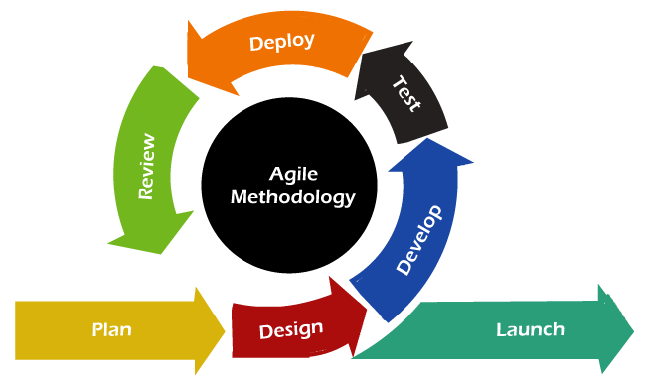
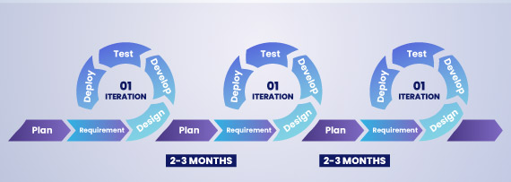
Agile Model
Agile SDLC model is a combination of iterative process models with focus on process adaptability and customer satisfaction by rapid delivery of working software product.
Agile methods break the product into small incremental builds. These builds are provided in iterations. Each iteration typically lasts from about one to three week

Slide 8
Advantages and Disadvantages
Advantages :-
Adaptability to change :- Agile’s flexibility allows teams to quickly respond
Reduced Risk :- Agile’s incremental delivery and frequent feedback reduce the risk of the project failure.
Improved Quality :- Agile’s focus on testing and continuous integration ensures higher quality products.
Disadvantages :-
High Customer Involvement :- Agile’s requires significant customer involvement, which can be time-consuming and demanding.
Difficulty in Scaling :- Agile can be challenging to scale to large, distributed teams or complex projects.
Potential for Burnout :- Agile’s fast paced and iterative nature can lead to burnout if not managed properly.

Slide 9
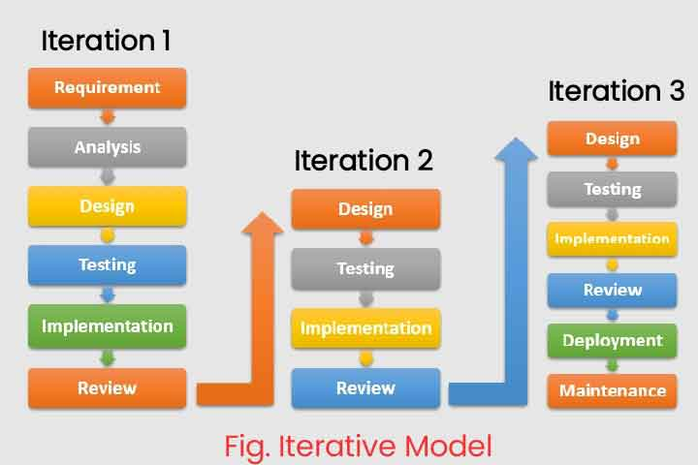
Iterative Model
Iterative model is a process of software development where requirements are broken down into multiple standalone modules of software development cycle. This process involves repeating the development cycle multiple times. Feedback from each iteration is used to reach customer expectations.

Slide 10
Advantages and Disadvantages
Advantages :-
Errors are easy to be identified.
Used in Large projects.
A customer feedback are taken after every iteration.
Disadvantages :-
More recourses required.
Deadline not confirmed.
Over budget.

Slide 11
Thank You

